Slide 1
Capstone Project - The Battle of the Neighborhoods (Week 5)
Applied Data Science Capstone by IBM/Coursera
Clustering National Capitals for Travelers

Slide 2
Introduction: Business Problem
In this project we will try to clustering national capitals cities. Specifically, this report will be targeted to stakeholders interested in travels to come to see the same or different cities, or to those who worked in tourism business.
Since we don't use information about how much cost this trip, we can help with choose destination for criteria how similar some cities with those they came to see before.

Slide 3
Data
Based on definition of our problem, informations that will need are:
list of capitals cities with population
geographical coordinates for every city
venues in every city for clustering
Following data sources will be needed to extract/generate the required information:
list of capitals with population we take from Wiki https://en.wikipedia.org/wiki/List_of_national_capitals_by_population
coordinates cities will be obtained using Nominatim from geopy.geocoders libraries
venues will be obtained using Foursquare API

Slide 4
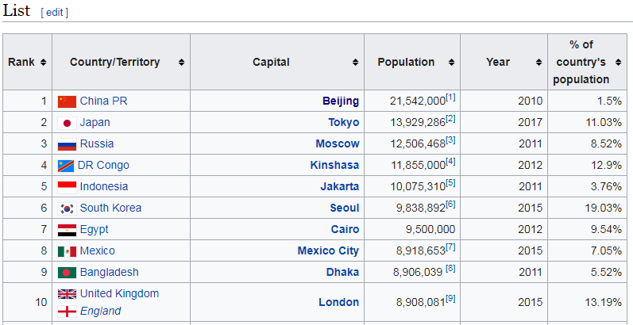
List of capitals cities with population from Wiki Page

Slide 5
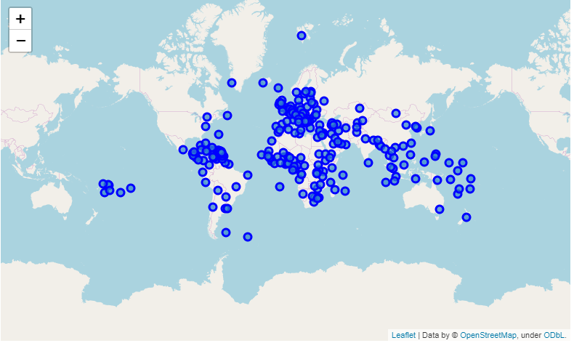
Capitals on the World Map

Slide 6
Venues from Foursquare API
For request to Foursquare API we need next things:
ID and Secret Password (took when we created Foursquare account)
Coordinates
Numbers of Venues
Radius of request

Slide 7
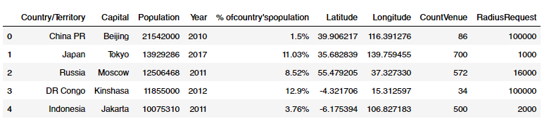
Table of data for request

Slide 8
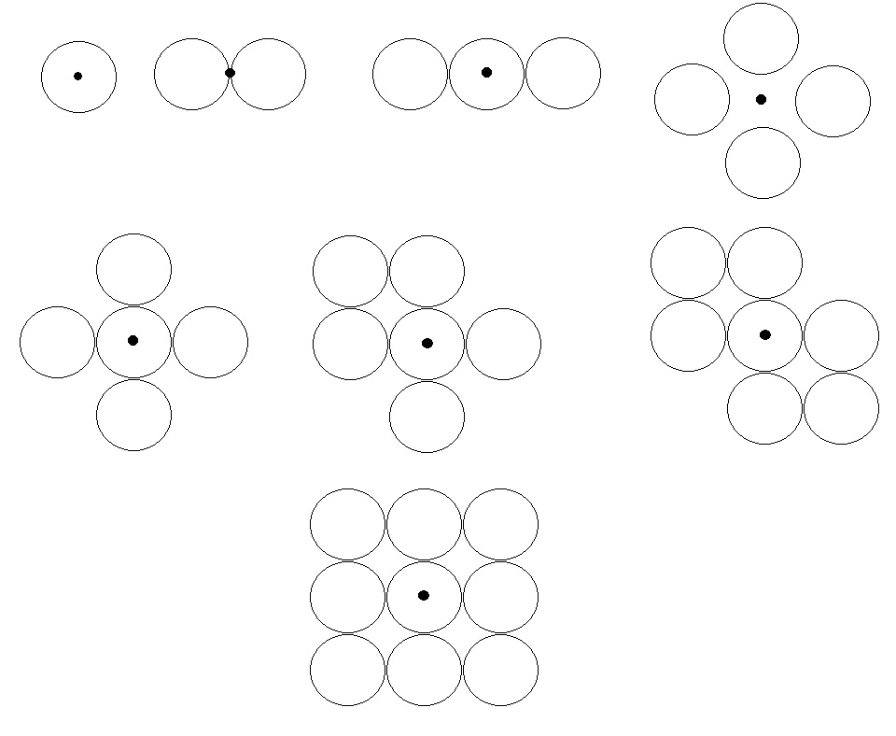
In one request we can take only 100 venues, so we need more points for every Capital
Scheme of points:
Black dot – Capital’s coordinates
Circle’s radius = radius from table

Slide 9
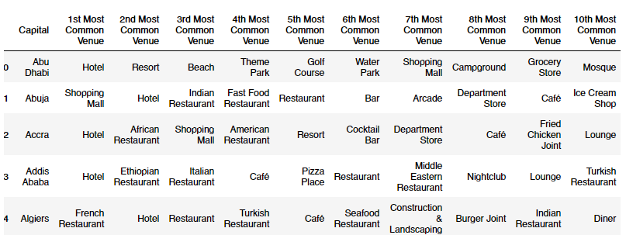
Methodology
For analysis data we use “k-means Clustering” from sklearn.cluster library with venue’s category.
In our data we have 600 uniques categories. For clustering we use mean venue’s count for categories for every capital.
In result we have 10 common category for every capital:

Slide 10
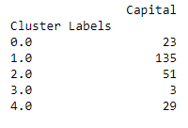
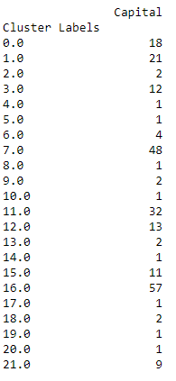
Clustering
In first we clustering to 5 clusters, count for every cluster was:
As we can see, one of the cluster was a lot more then others, so we try from 3 to 125 cluster to find the most suitable.
And it is 22:

Slide 11
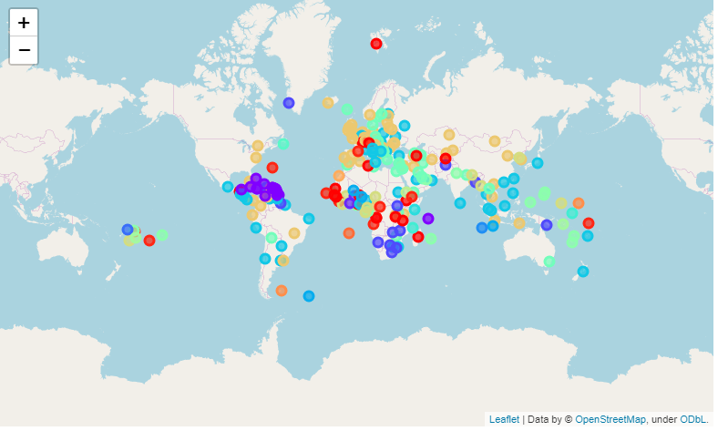
Result on the World Map

Slide 12
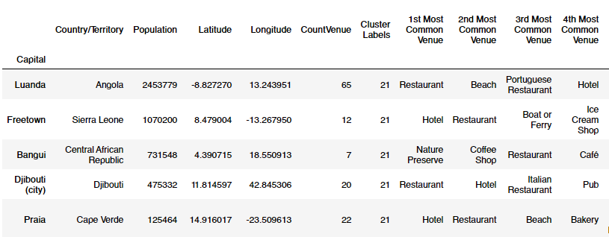
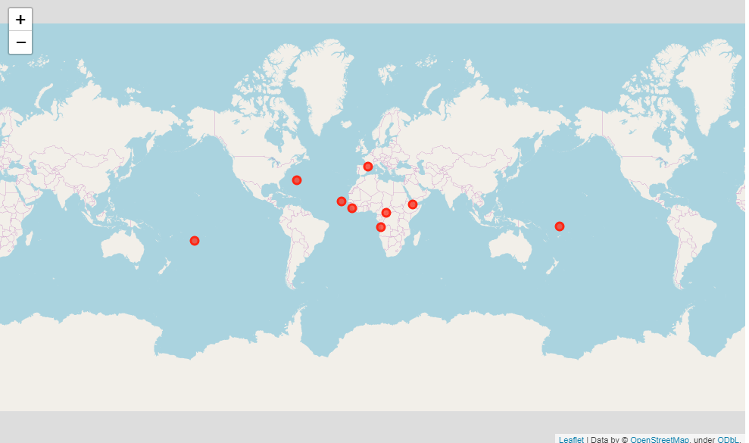
Cluster 22

Slide 13
Thanks for watching

